Slide 1
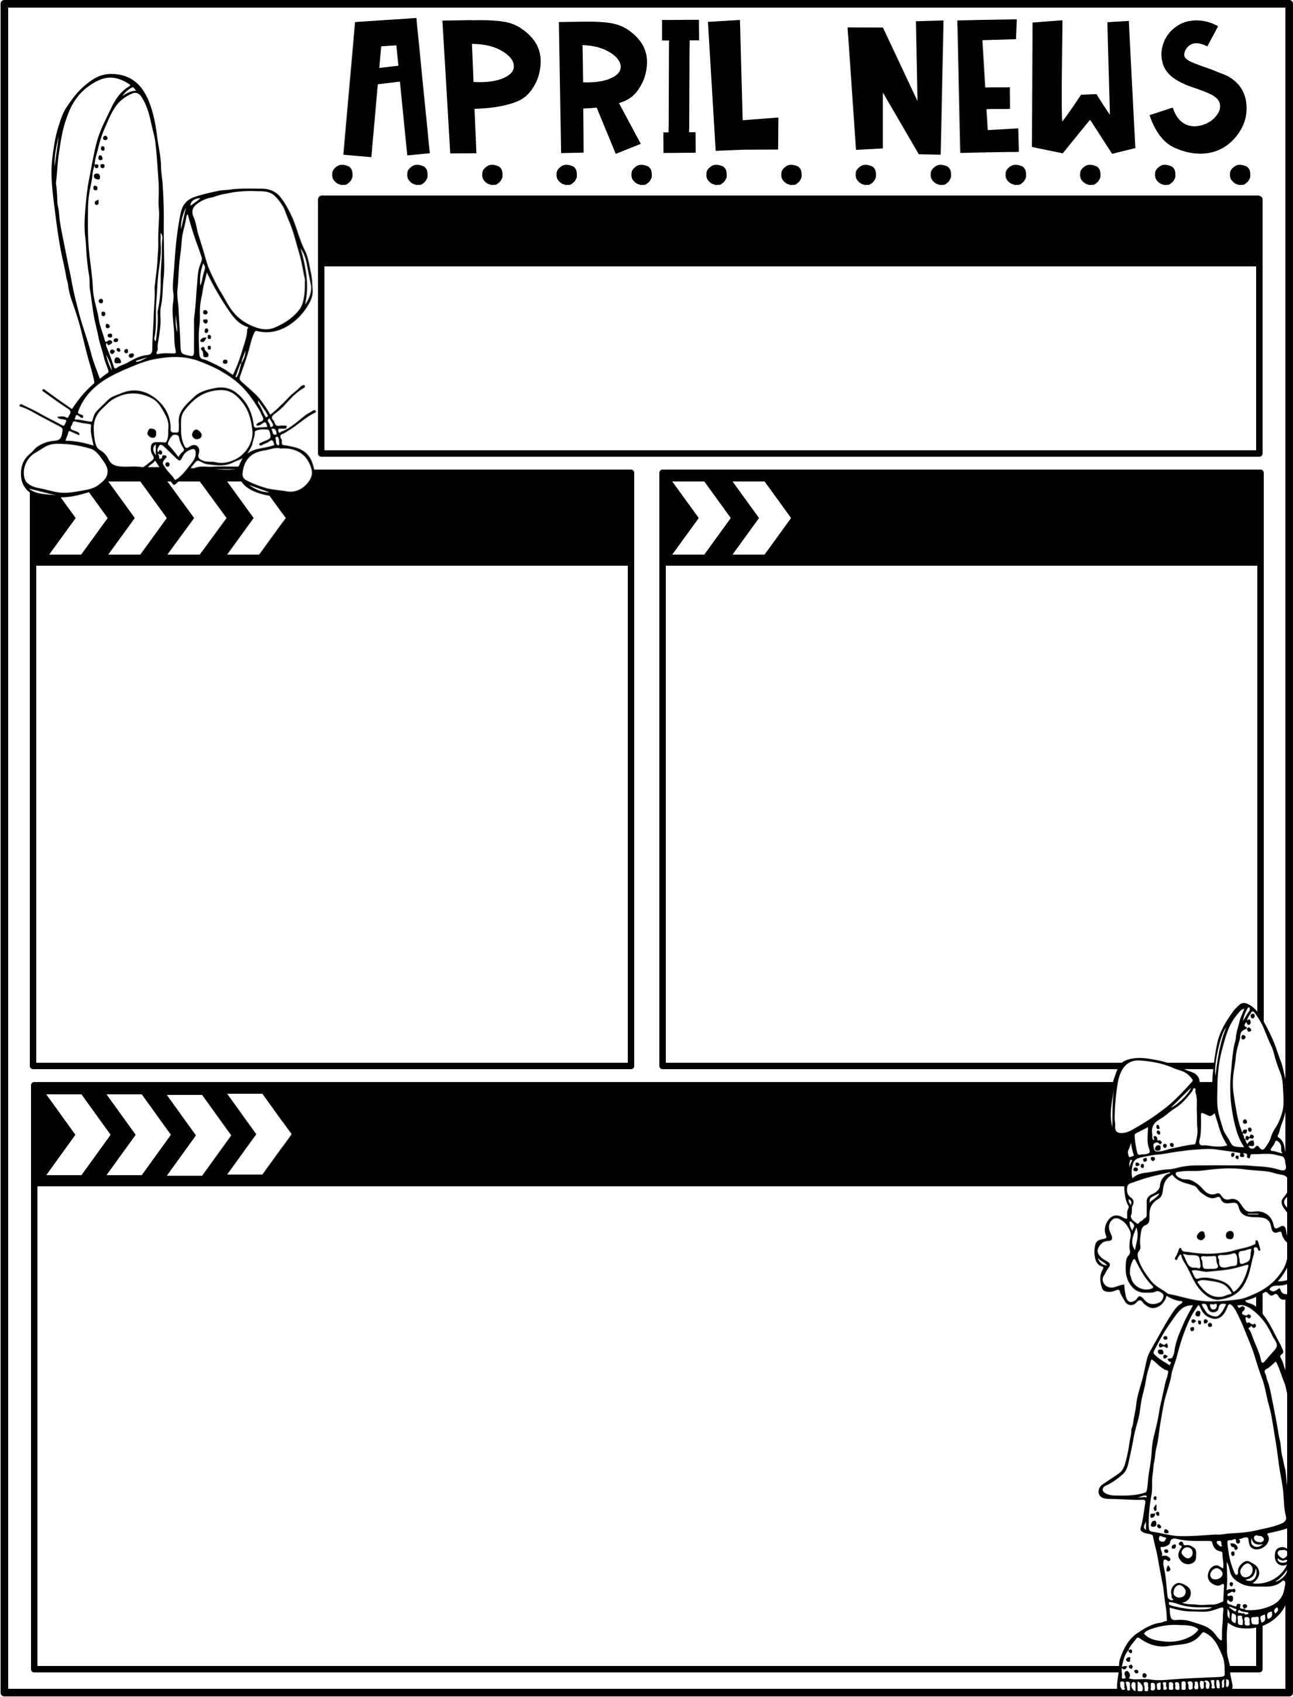
April 25, 2025
The Moreau Heights family is committed to providing a positive and safe learning environment to support responsible and productive citizens.
Phone:
573-659-3180
Plan Time:
1:35-2:25 pm
Emails:
mason.johnson@jcschools.us
danielle.mcgeorge@jcschools.us
theresa.schell@jcschools.us
Calendar
Learning Targets
M 04/28 C Day
T 04/29 A Day
W 04/30 B Day
Th 05/01 C Day
F 05/02 A Day, Library Checkout
M 05/05 B Day
T 05/06 C Day
W 05/07 A Day
Th 05/08 B Day
F 05/09 C Day, Library Checkout
Reading/Writing
I can read closely and answer text-dependent questions.
I can add details to create more complex sentences.
I can sort words based on their syllables.
I can answer multiple choice questions & a short answer question about the chapter.
Math
I can compose equal groups & write repeated addition equations.
I can use math drawings to represent equal groups & relate them to repeated addition.
I can represent equal groups with a tape diagram.
I can compose arrays with rows & columns & use a repeated count to find the total.
Social Studies
I can tell about people that shaped our nation.
Things to Know
Specials Schedule:
Library Check-Out:
Second grade has check-out on Fridays! Please help your child remember their books!
If you would like to send in
Snacks for our class that would
Be great!!!!
Please continue to read with your
Child at home!
 | Mr. J | Mrs. M | Ms. S
A | Music | PE | Art
B | PE | Art | Music
C | Art | Music | PE

